Slide 1
Passé Simple

Slide 2
Objective:
SWBAT form and accurately use the academic past tense.

Slide 3
What is the passé simple?
Well, it means the same thing as the «passé composé. »
  PC/ PS = ‘ed’ form of the verb.
  I believed
  I helped

Slide 4
Forming the Passé Simple
The first piece you need to find is the past participle from the passé composé
  J’ai regardé - regardé
  il a trouvé- trouvé
  nous avons quitté - quitté
This rule is more helpful for what we are doing next.

Slide 5
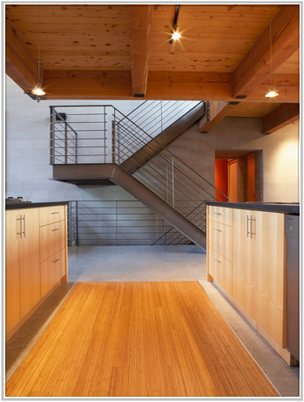
for er verbs
Write your past participle. Switch out the ending for:
ai
as
a
âmes
ates
èrent

Slide 6
So, the verb penser
j’ai pensé - pensé
  je pensAI
  tu pensAS
  il pensA
  nous pensAMES
  vous pensATES
  ils pensÈRENT

Slide 7
Now we can say the same thing two ways:
P.C. | P.S.
j’ai trouvé | je trouvai
tu as mangé | tu mangas
il a joué | il joua
nous avons frappé | nous frappâmes
vous avez dansé | vous dansates
ils ont sauté | ils sautèrent

Slide 8
  Day 2: Forming IR verbs
IR verbs follow the same pattern.
  find the past participle
    ir- i
    j’ai minci - minci
    tu as fini - fini
    il a guéri - guéri

Slide 9
Get rid of the I
Your endings are
  is
  is
  it
  îmes
  ites
  irent

Slide 10
So, finir would be:
je finis
tu finis
il finit
nous finîmes
vous finites
ils finirent

Slide 11
  Day 3: RE verbs
just like the other two, find your past participle.
  re- u
  j’ai mordu - mordu
  tu as tordu - tordu
  il a répondu - répondu

Slide 12
Replace it with the following endings:
us
us
ut
ûmes
ûtes
urent

Slide 13
mordre: to bite
j’ai mordu - je mordus
Tu as mordu - tu mordus
il a mordu - il mordut
nous avons mordu - nous mordûmes
vous avez mordu - vous mordûmes
ils ont mordu - ils mordurent

Slide 14
Day 4: Patterned irregulars
What is a patterned irregular?
  It is a verb that has an irregular past participle, but still follows the pattern we have learned.

Slide 15

Several of them
Verb | P.P.
avoir | eu
Devoir | Du
pouvoir | pu
vouloir | voulu
boire | bu
croire | cru
voir | vu
savoir | su
vivre | vécu

Slide 16
A few others
Mettre: to put on P.P.: mis

Slide 17
The rule
If you’re using an irregular past participle, look at the last letter.
  If the last letter is u, use the re endings
  if it is I, use the ir endings
  if it is é, use the er endings

Slide 18
Day 5: Real Irregulars
These are the ones you just need to know

Slide 19
prendre (comprendre, surprendre)
pr is your stem, it takes the ir verb endings
pris
pris
prit
prîmes
prîtes
prirent

Slide 20
faire
BE CAREFUL!!!! Your stem is fi and it takes ir endings
fis
fis
fit
fîmes
fîtes
firent

Slide 21
être
THIS IS THE DIFFICULT ONE
fu- the stem
je fus
tu fus
il fut
nous fûmes
vous fûtes
ils furent

Slide 22
Tenir: to hold
tins
tins
tint
tinmes
tintes
tinrent

Slide 23
Others like it:
soutenir: to sustain
se tenir: to stand
maintenir: to maintain
venir (change the t to a v): to come from
souvenir: to remember
prevenir: to warn

